Slide 1
THE MOST BASIC DISTORTION EVER
A GibbyDSP Plug-in

Slide 2
WHAT IS MY PLUGIN?
I made a minimalist Distortion Plugin
Gain, Volume, Mix sliders
Did not get to the point of filter implementation unfortunately

Slide 3
WHY THIS PROJECT?
I like rock music
I am in a rock and roll band called Trash Rabbit
I have been wanting to make a small trash distortion that actually sounds good for a while that I can give away as a little treat to some fans at shows.
Inspired by the Rat distortion pedal
Gain, Filter and Volume
Goal was to create something similar

Slide 4
DEMO
LET’S CHECK IT OUT LIVE IN ACTION

Slide 5
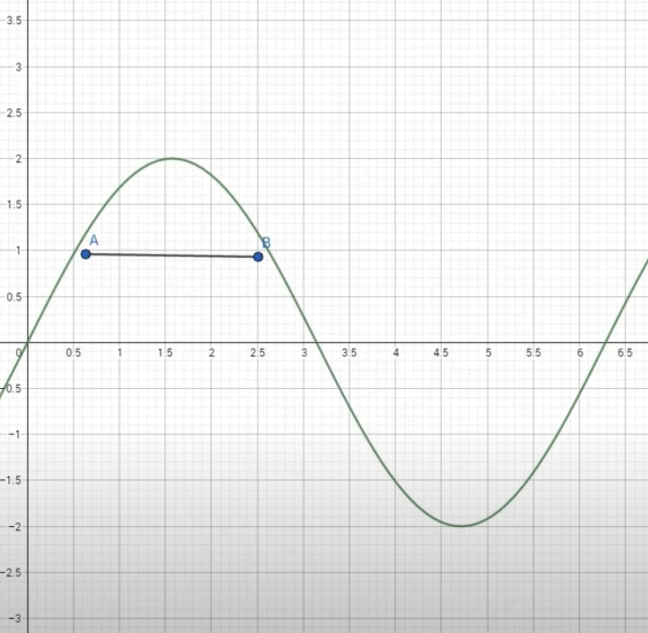
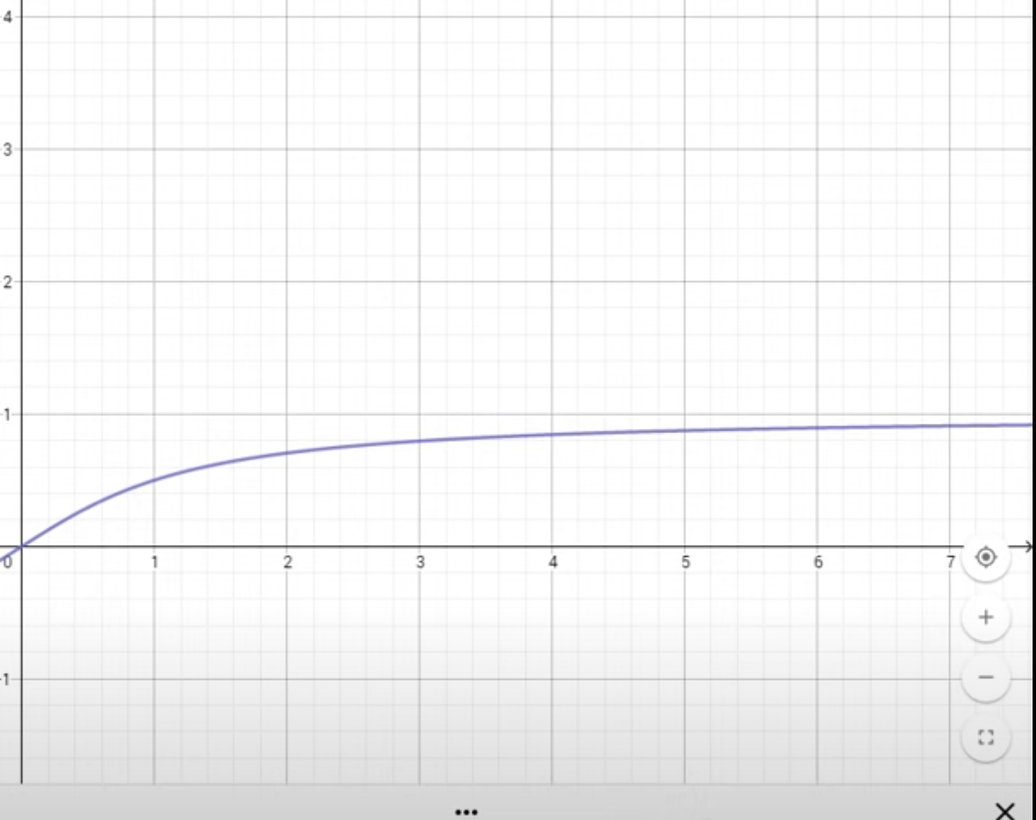
How this plug in works
Here’s the code:
*channelData = ((((2.f / juce::MathConstants<float>::pi) * atan(*channelData)) * MixLevel) +(((cleanSig)*(1-MixLevel))))*VolumeLevel;
Based of Arctangent soft clipping distortion
Distortion != Xtra Loud
Think of distortion almost as a limiter clipping everything above a threshold
(2/pi) atan(x)

Slide 6
OH BOY WAS THIS TOUGH
Plug in development wit JUCE and C++ was a lot more difficult to begin with compared to previous plug-ins I have built with Cabbage and Csound.
However, I do see why JUCE is very popular for plugin development because you can do a lot more design yourself and customize a lot more where in Csound you can be limited by available opcodes.
One of the biggest struggles I had was GUI implementation and integration.
Looking at tutorials that didn’t do me any good.
Did not get to implement a filter

Slide 7
Positives
Honestly was a little fun once I got the hang of it but the learning curve was definitely steep
Feel like I have a better understanding of how more plugins work
I will definitely be continuing to tackle JUCE and keep using it to expand this plugin and make future ones because of the versatility of the framework and the ability to create completely new things
Easier to export VST3s and AUs than Cabbage

Slide 8
Next Steps
After this semester is over and all my finals are done I plan on coming back to this plugin and adding a filter and parameter controls for that as well.
I also want to update the GUI a little big to make it more presentable even though the GUI is what I struggled the most with by far.

